Slide 1


International Technology Olympics
An interactive journey to develop digital skills
3rd edition

Slide 2
INDEX
About NTT DATA FOUNDATION
Objective
What it consists of
Who is it for? Impact
Methodology
Final competition
Why should I participate?
Team
Calendar

Slide 3



NTT DATA FOUNDATION: 23 years of history
Objective: to put technology at the service of society.
All of the Foundation's activities are scalable, through technology, sustainable and have local application and global reach.
We are currently focused on two lines of action:
Entrepreneurship support
Digital skills development
Entrepreneurship Awards “eAwards”
For adults:
Digital Talent School
For children:
Technology Olympics
17 27 +3800
Countries*
Offices
Volunteers
(NTT professionals) NTT DATA)
*Germany, Argentina, Austria, Belgium, Brazil, Chile, Colombia, Spain, USA, Netherlands, Italy, Mexico, Peru, Portugal, United Kingdom, Romania, Switzerland

Slide 4


OBJECTIVE
Contribute to reducing the digital divide in children and adolescents, bringing them in a playful way to programming and technology not only as consumers, but also as producers.
Our workshops in figures
+1000
Volunteers
(from NTT DATA as trainers)
+7.000
Children and young people impacted
13 countries
from Europe and Latin America

Slide 5



WHAT DOES IT CONSIST OF
It is an interactive journey to develop digital skills.
During the tour, participants will realize what they are capable of through programming and technology.
Following the Olympics scheme, they will receive training that will allow them to compete in the grand final to put the acquired skills into practice.
This is what the Olympics are like:
During the Olympics:
They will know the bases of computational thinking.
They will stimulate your creativity, your ability to detect problems and propose solutions, your communication skills, your discipline and your perseverance.
They will develop video games and animations with Scratch.
They will know the basic concepts of Artificial Intelligence.
They will acquire tools that will be essential throughout their lives.
Notes:
¿Qué es lo que proponemos desde la fundación NTT DATA?
Una plataforma de competencias digitales donde, a través de un itinerario formativo lúdico de 12 sesiones (síncronas y asíncronas), se puedan formar en programación durante 3 meses de duración y finalicen con una competición y Olimpiadas por niveles.
¿A qué edades nos dirigimos? A niños y adolescentes con edades entre los 7 los 16 años. Además de competir por niveles de conocimiento, también lo harán en dos grupos de edades.
Los participantes estarán acompañados en todo momento por la figura de un entrenador, que es un voluntario de la compañía y que les guiará en su formación.
¿Por qué hacemos esto y por qué podemos garantizar la calidad de lo que estamos haciendo?
Llevamos años realizando sesiones de tecnología: de forma presencial, virtual, de forma lúdica y con voluntarios, transmitiendo el uso responsable de la tecnología para que no solo sean consumidores, sino creadores de tecnología. Todos los niños saben manejar un teléfono móvil pero es esencial también que desarrollen otras habilidades ya que la tecnología está presente en todos los aspectos de nuestra vida.
Y bueno, aquí hay unos datos de lo que hemos

Slide 6


MULTIPLIER IMPACT
WHO IS IT FOR?
Children and adolescents between 7 and 16 years old. The competition will be divided into two age segments:
Primary: from 7 to 11/12 years, approx.
Secondary: from 12 to 16 years, approx.
The Olympics (platform, talks, content, videos, etc.) will be available in Spanish, English, Portuguese and Italian.
Children from 13 countries will be participating simultaneously in the competition
Olympics include two online sessions for trainers so that they can actively support the children and replicate the information and workshops in a sustainable and autonomous way.
BRIEFING SESSION
Registration process on the platform, etc.
February 26th
17:30 to 18:30
TRAINING SESSION (Optional)
Basic training in computational thinking and Scratch
March 21th
17:00 to 18:30
Notes:
Cifra especialmente alta al tratarse de una “extraescolar” online, gratuita y sin supervisión directa de padres, profesores o tutores. Cada niño avanza a su propio ritmo.

Slide 7


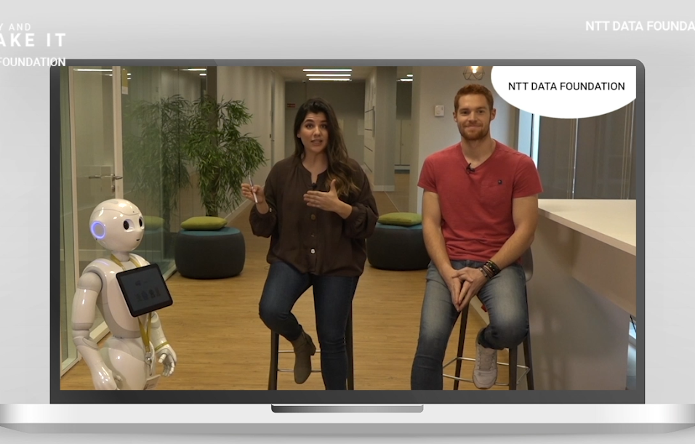
METHODOLOGY
The Olympics are developed through a platform divided into 10 modules.
In each module, participants will find fun-training videos and challenges so that they can develop their creativity and test what they have learned.
With each completed module you will accumulate “keys” (points) that, like technology, will allow you to open new doors.
Depending on the number of keys acquired, they will be classified into various categories for the grand final competition.
Click on the image to see how the platform works
Participants will be able to advance at their own pace and will have personal trainers who, in addition to teaching group sessions, will be available at all times to help them continue advancing.

Slide 8


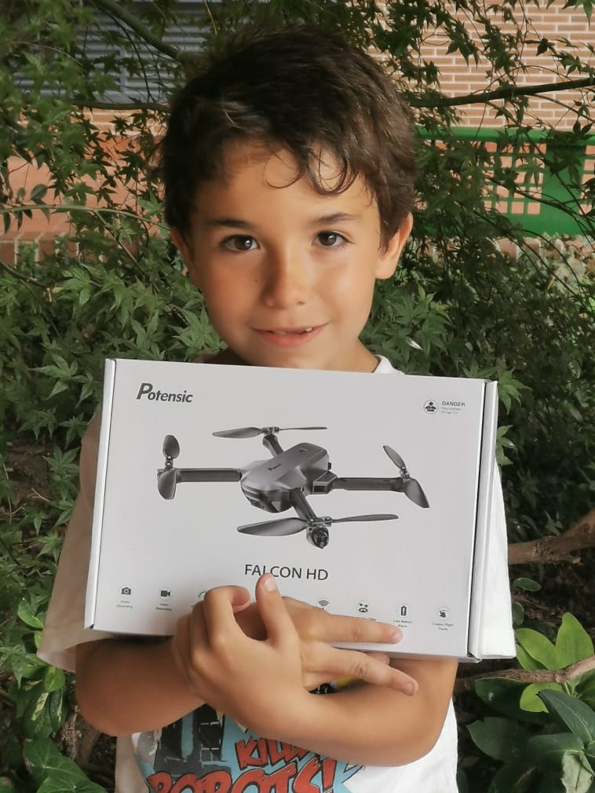



FINAL COMPETITION
Once participants have completed the 10 modules of the platform, they will receive a challenge according to the category in which they have been classified.
With the challenges, in addition to demonstrating the digital skills acquired, they will provide solutions to problems in their environment in which the values ​​that we promote as a Foundation will also be highlighted.
Examples of challenges:
BEGINNER LEVEL
Create an animation in which you teach your grandparents how to connect to WIFI
MEDIUM LEVEL
Create a video game or a movie in which you show your friends how to avoid bullying at school
ADVANCED LEVEL
Create a video game with at least three characters in which you include conditional variables to show the inhabitants of planet MQ 47 how to take care of their natural resources
6 prizes will be awarded to the participants and special recognition will be given to the educational centers and trainers most involved in the Olympics.
Meet the winner of the 1st edition

Slide 9

WHY SHOULD I PARTICIPATE?
Because it is the best opportunity to awaken their interest in programming and bring them closer to the bases of computational thinking in a fun and practical way.
What does a school need to participate?
ONLY needs one interested coordinator who will:
Attend a 1-hour online briefing with details of the activity
(Optional) Attend a 1.5 hour online training session on Scratch and Computational Thinking
Our volunteers will be in charge of the participants' questions and progress.
Because they are based on a pedagogical model that allows them to develop digital competencies and soft skills such as creativity, critical thinking and communication that will be decisive for their lives.
What do minors need?
Because, without feeling it like an academic burden, they will eliminate the taboo that relates difficulty to programming and technology.
A computer
Internet connection
If you can imagine it, you can create it!

Slide 10

TEAM
NTT DATA FOUNDATION
EDUCATIONAL CENTERS AND/OR TRAINERS
BENEFICIARIES
Provides design, content, platform, methodology, support and monitoring throughout the journey, coaches, evaluators, juries, etc.
They can incorporate technology olympics into some of the classes and/or encourage and stimulate student participation in an extracurricular way.
Children and adolescents (recommended ages between 7 and 16 years).
They can participate:
With support from the educational center.
In an independent way.
Teachers, you are the real influencers
Your drive will be decisive for their future
To participate with your students in the Olympics
Click here
This registration link will be operational EXCLUSIVELY between February 9 and April 2, 2024

Slide 11

ONE MORE THING…
Teachers interested in having their students participate in the Olympics and also want to train in the subject may participate in the sessions that we will teach previously.
*It is not essential that the teacher, school or institution participate in this training. It is presented as “extra”. Classes and monitoring are carried out by Foundation volunteers.
CALENDAR
Participant registration
Platform opening and training process
Preparation of the
final challenge
International final and selection of winners
Until February, 4th
April, 8th – May, 24th
May, 27th – June, 7th
June, 18th

Slide 12
THANK YOU!
nttdatafoundation@nttdata.com
@nttdatafoundation

